Slide 1

Exploratory data analysis in real estate pricing
A presentation by Vaishali Luthra

Slide 2

Agenda
1 | Challenges Faced During the Project
2 | Sale Price Distribution
3 | Correlation analysis
4 | Size impact on house price
5 | Market trends over time
6 | Amenities impact on price
7 | conclusion

Slide 3

INTRODUCTION
The real estate market is complex and influenced by several factors such as property size, location, amenities, quality, and market conditions. Accurately determining house prices requires a deep understanding of how these variables interact with each other.
In this project, Exploratory Data Analysis (EDA) is performed on a housing dataset to identify the key factors affecting house prices. Various data visualization and statistical techniques are used to uncover patterns, relationships, and trends within the data.
The objective of this analysis is to support data-driven decision-making in real estate pricing and to provide meaningful insights that can help improve valuation strategies.

Slide 4
Challenges Faced During the Project
3
5
Understanding a dataset with large number of features and identifying the most important variables influencing house prices.
Selecting appropriate visualizations to clearly represent relationships between features and sale price.
Handling missing values, duplicate records, and inconsistent data types during data cleaning.
1
4
6
Performing feature engineering to derive meaningful attributes such as price per square foot and house age.
Interpreting insights in a business-oriented manner rather than just technical result
2
Analyzing market trends without a complete date column, which required year-wise aggregation.

Slide 5
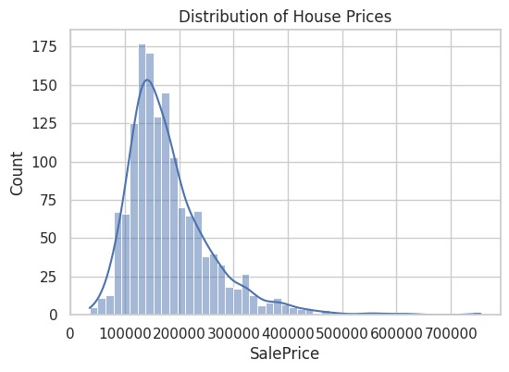
Sale Price Distribution
This plot shows the distribution of house sale prices. The distribution is right-skewed, indicating that most houses are priced in the lower to mid range, with a few high-value properties acting as outliers. Identifying these outliers is important for understanding market extremes and pricing variability.

Slide 6
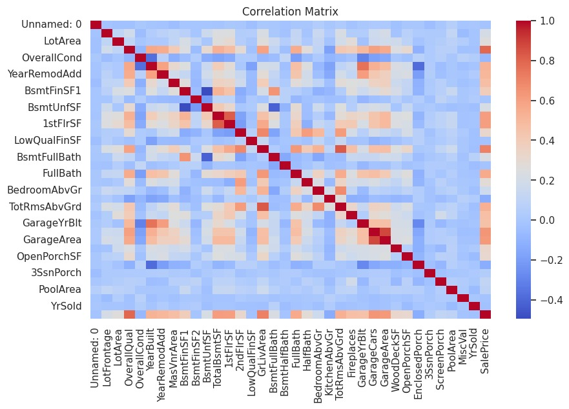
Correlation Analysis
The correlation heatmap highlights the relationship between different numerical features and sale price. Features such as gross living area and overall quality show strong positive correlation with sale price, indicating that these are major drivers of house valuation.

Slide 7
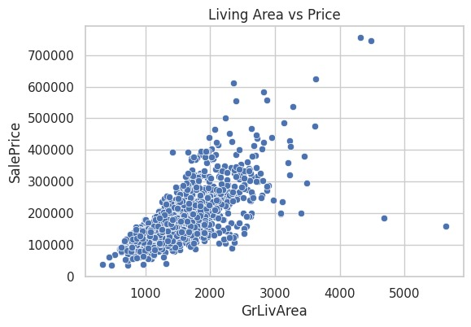
Size Impact on House Price
This plot illustrates the relationship between house size and sale price. A strong positive trend is observed, showing that houses with larger living areas generally command higher prices. This confirms that property size is one of the most influential factors in pricing.

Slide 8
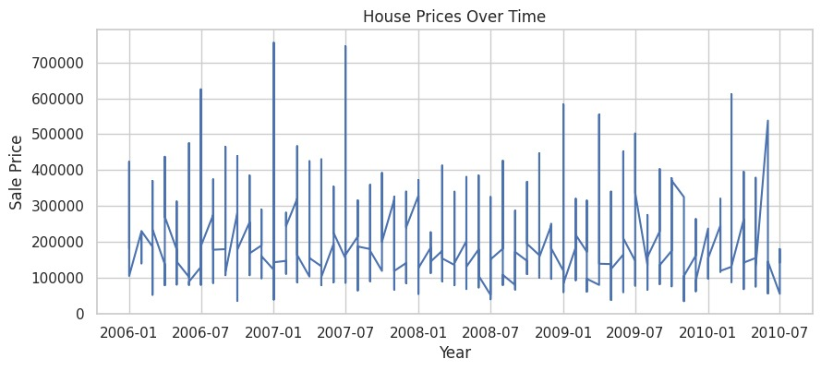
Market Trends Over Time
This time-based analysis shows how average house prices change over the years. The fluctuations in prices reflect market conditions, economic factors, and demand-supply variations, helping to understand historical pricing trends.

Slide 9
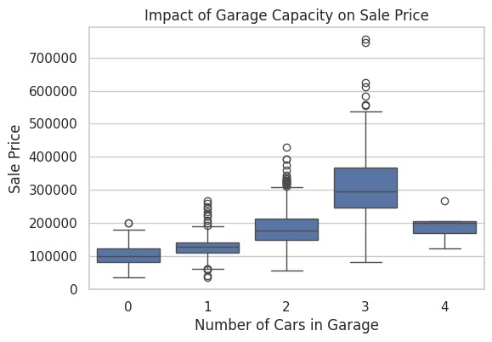


amenities Impact on Price
This analysis evaluates how amenities affect house prices. Properties with value-added features such as garages, fireplaces, or pools generally have higher sale prices. This highlights the importance of customer preferences and additional facilities in real estate valuation.

Slide 10
conclusion
The Exploratory Data Analysis revealed that house prices are primarily influenced by property size, overall quality, and key amenities. Feature engineering helped in gaining deeper insights, while trend analysis provided an understanding of market behavior over time.
Overall, this project demonstrates how EDA can be effectively used to support data-driven pricing strategies and lays the foundation for future predictive modeling in real estate analytics.

